Slide 1
Final Project
Modules:
SQL
Python
Tableau
Power BI
Elvin Huseynzade

Slide 2
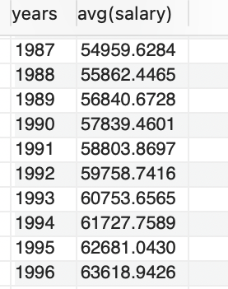
SQL
Average employee salary for every year.
select year(from_date) as years, avg(salary)
from salaries
group by year(from_date);

Slide 3
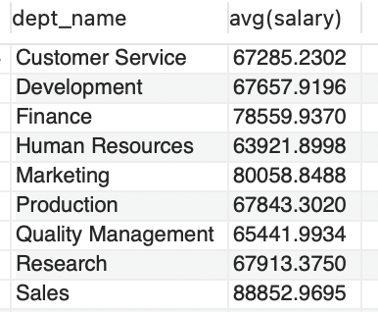
The average employee salary for every department.
select dept_name, avg(salary) from salaries
join dept_emp on salaries.emp_no = dept_emp.emp_no
join departments on dept_emp.dept_no = departments.dept_no
where curdate() < salaries.to_date and curdate() < dept_emp.to_date
group by dept_name;

Slide 4
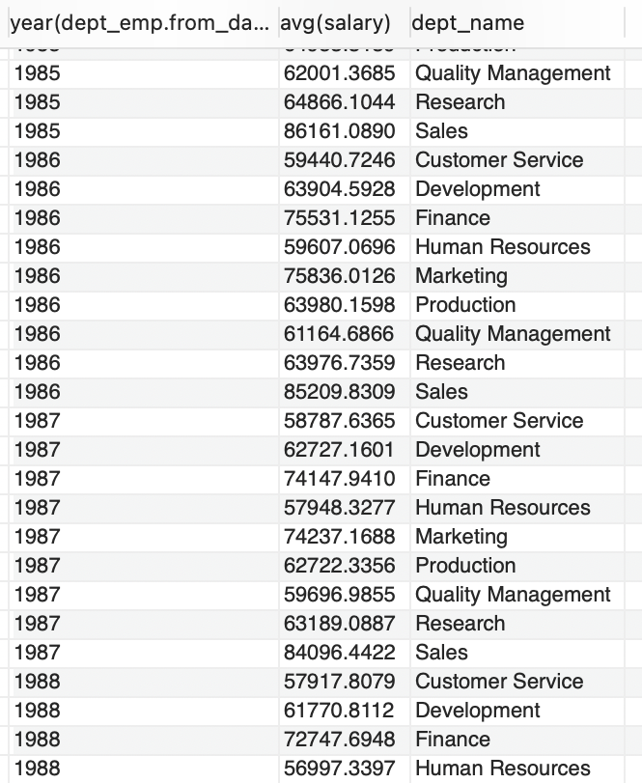
the average employee salary for every department for every year.
select year(dept_emp.from_date), avg(salary), departments.dept_name from salaries
join dept_emp on salaries.emp_no = dept_emp.emp_no
join departments on dept_emp.dept_no = departments.dept_no
group by year(dept_emp.from_date), departments.dept_name
order by year(dept_emp.from_date) asc;

Slide 5
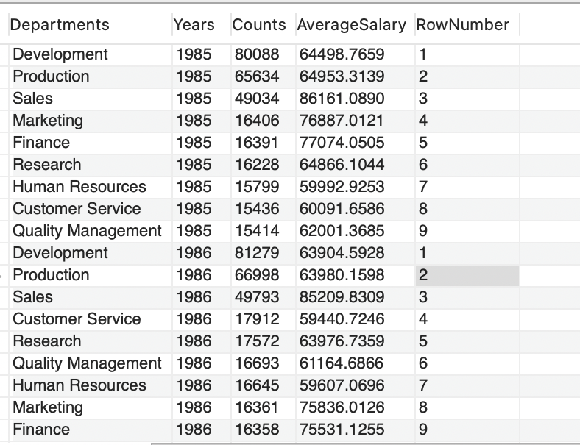
for each year, the largest department in that year, and its average salary
select departments.dept_name as Departments,
year(dept_emp.from_date) as Years,
count(dept_emp.emp_no) as Counts,
avg(salaries.salary) as AverageSalary,
row_number() over (
partition by year(dept_emp.from_date)
order by count(dept_emp.emp_no)
desc) as RowNumber
from dept_emp
join salaries on dept_emp.emp_no = salaries.emp_no
join departments on dept_emp.dept_no = departments.dept_no
group by Departments,Years;

Slide 6
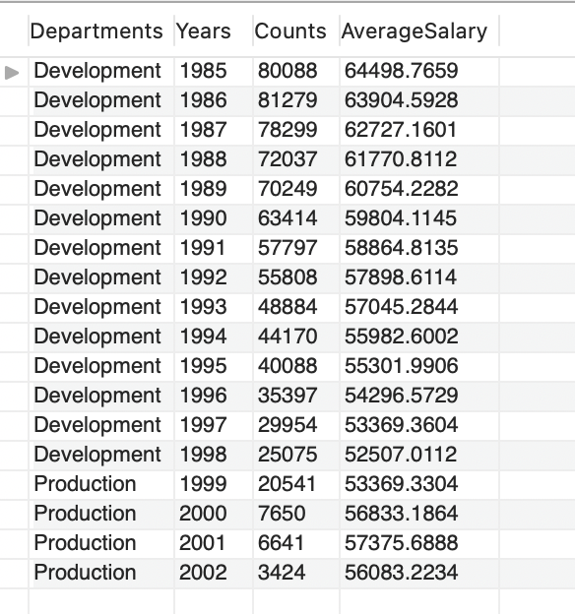
for each year, the largest department in that year, and its average salary
select t.Departments, t.Years, t.Counts, t.AverageSalary from
(select departments.dept_name as Departments,
year(dept_emp.from_date) as Years,
count(dept_emp.emp_no) as Counts,
avg(salaries.salary) as AverageSalary,
row_number() over (partition by year(dept_emp.from_date)
order by count(dept_emp.emp_no) desc) as RowNumber
from dept_emp join
salaries on dept_emp.emp_no=salaries.emp_no
join departments on dept_emp.dept_no = departments.dept_no
group by Departments,Years) t
where RowNumber = 1;

Slide 7
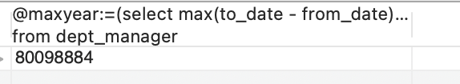
the details of the ​current ​manager who is the longest time in their role, i.e. show the details of the most senior (current)manager
select
@maxyear:=(select max(to_date - from_date) as years
from dept_manager
where to_date > curdate());
select * from dept_manager
join employees on dept_manager.emp_no = employees.emp_no
where to_date - from_date = @maxyear and to_date > curdate();

Slide 8
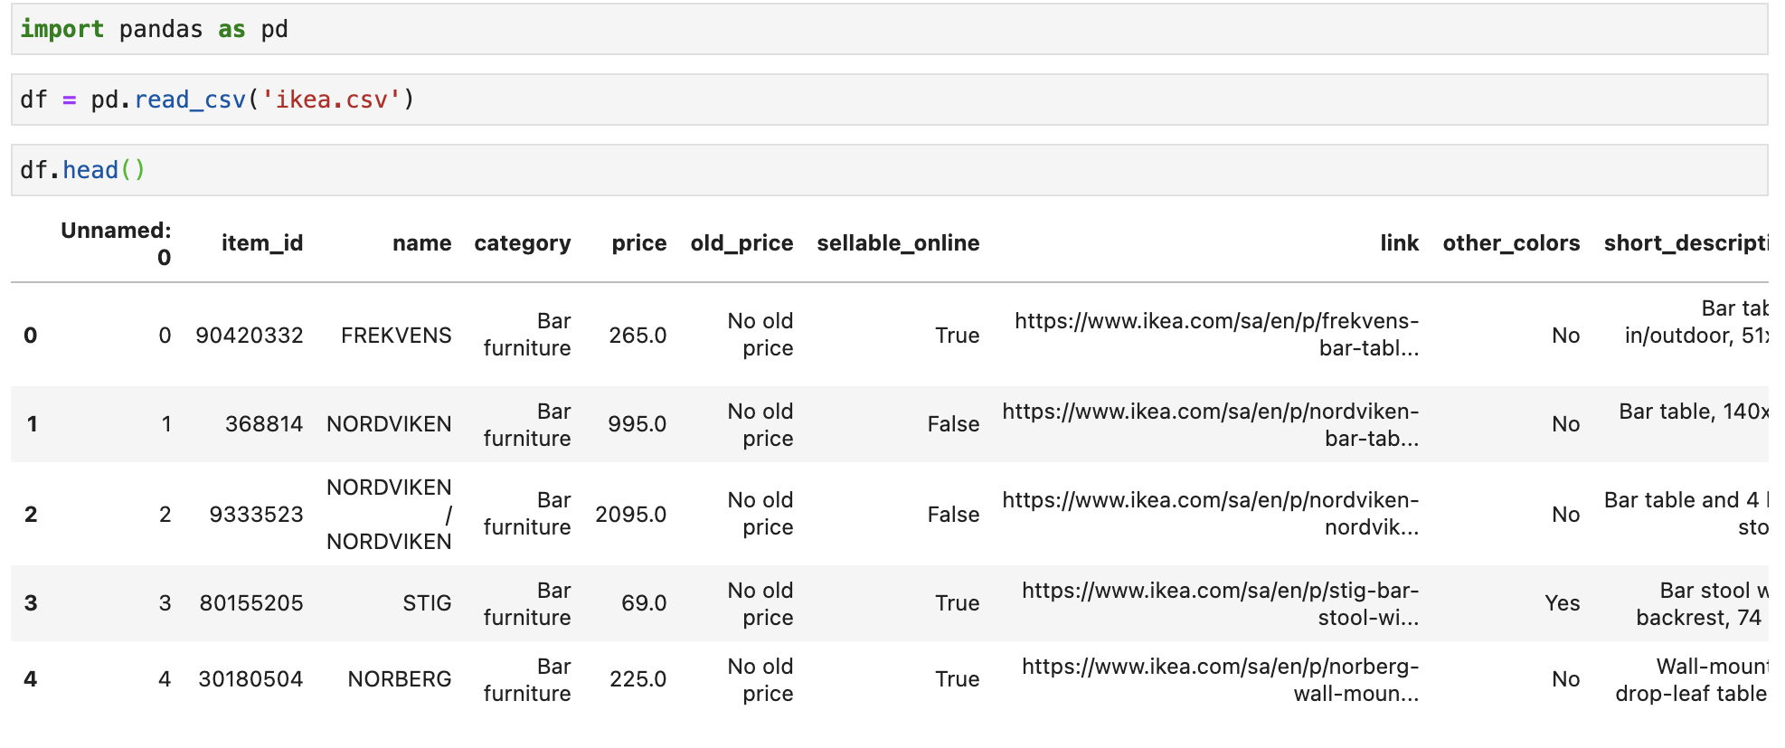
PYthon
Load Dataset

Slide 9
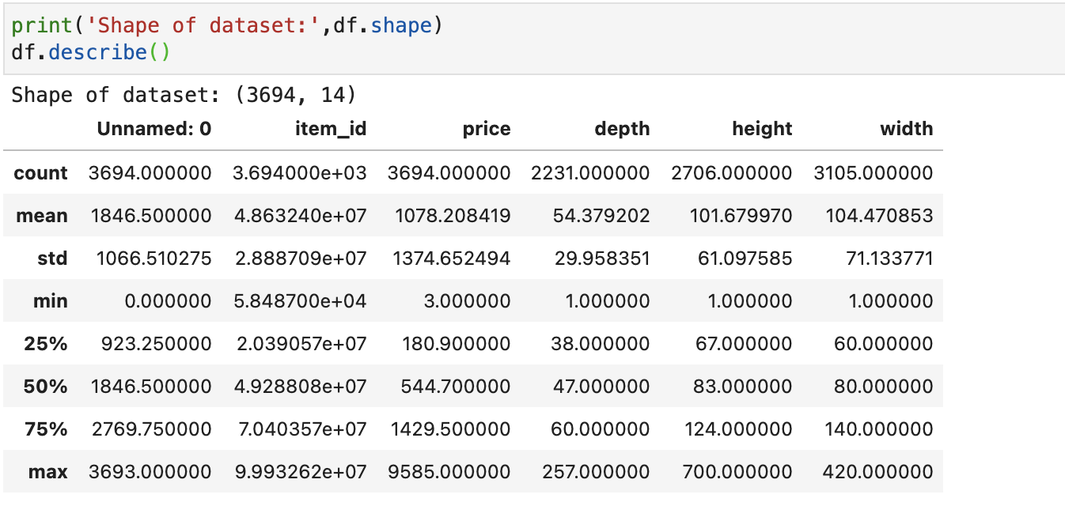
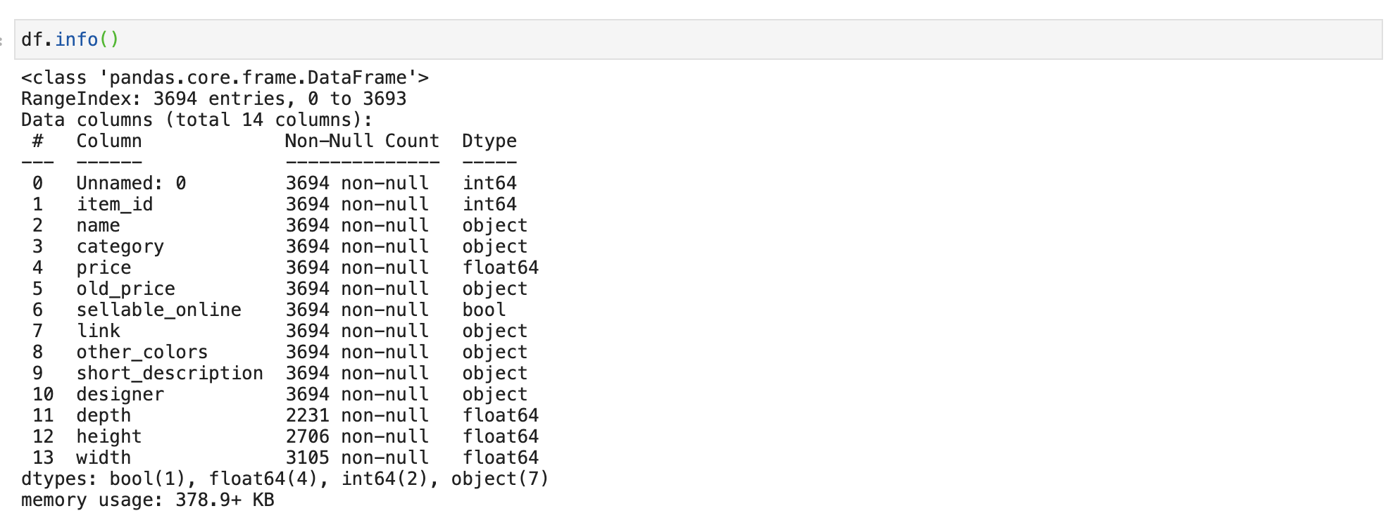
Main info and extra details

Slide 10
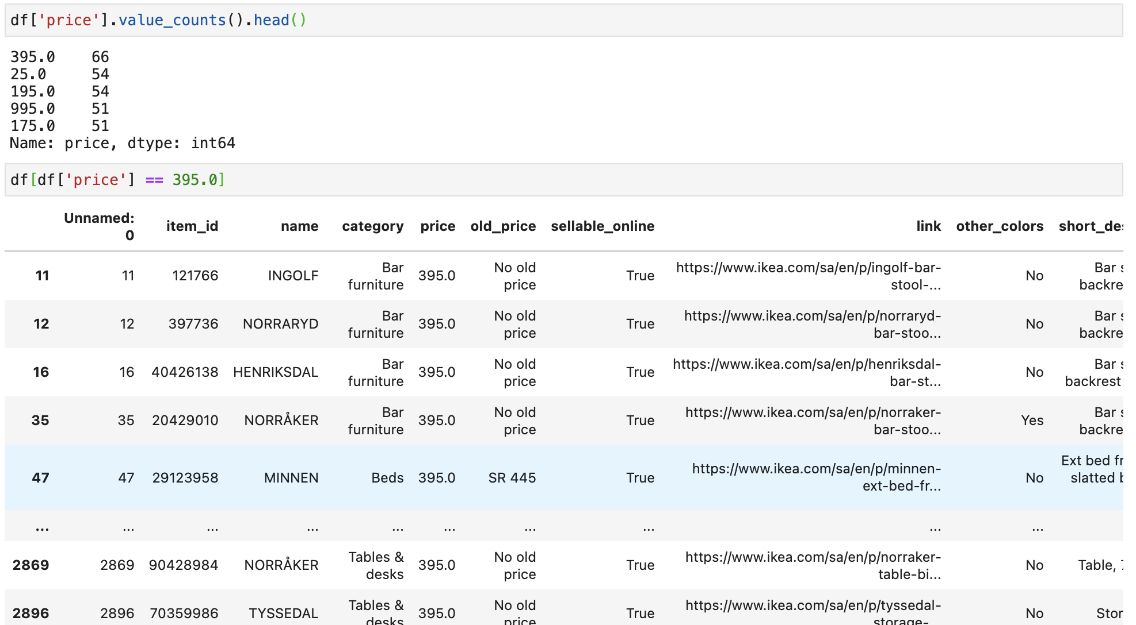
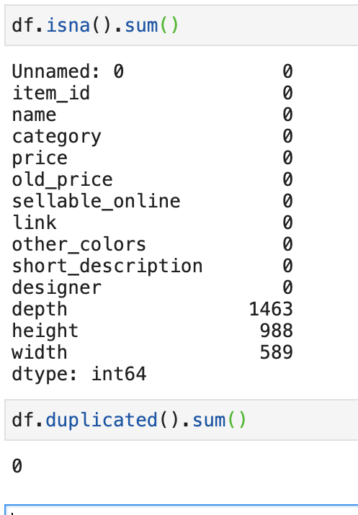
Missing values

Slide 11
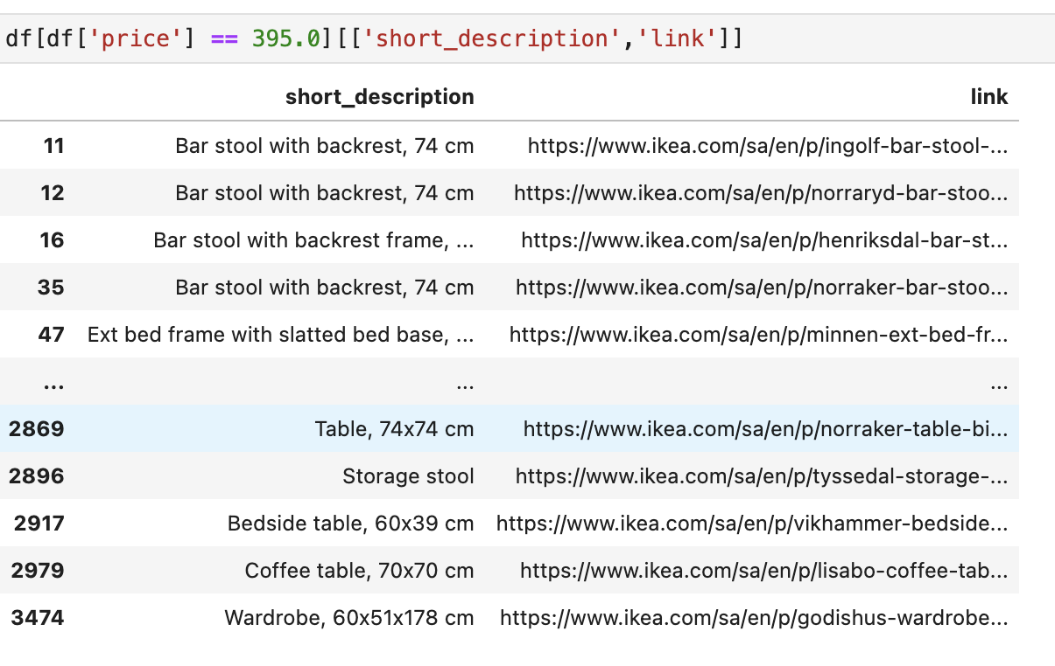

Slide 12
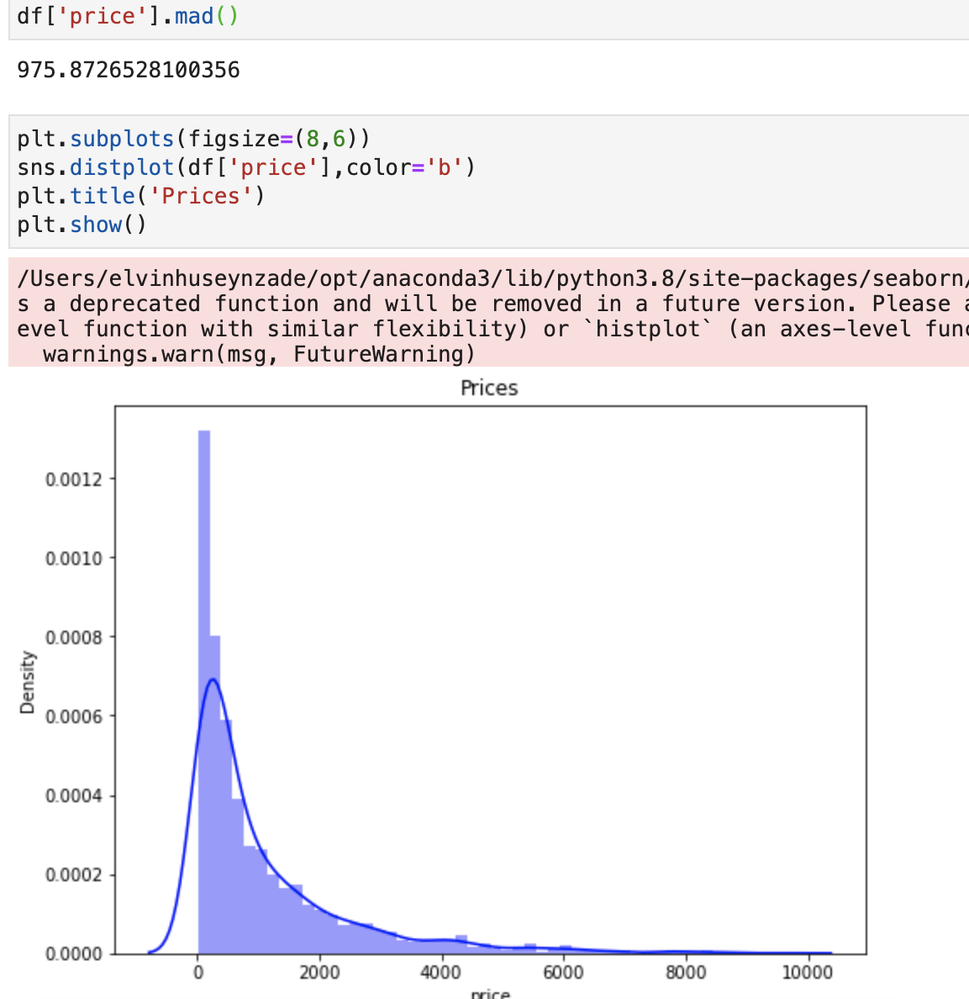
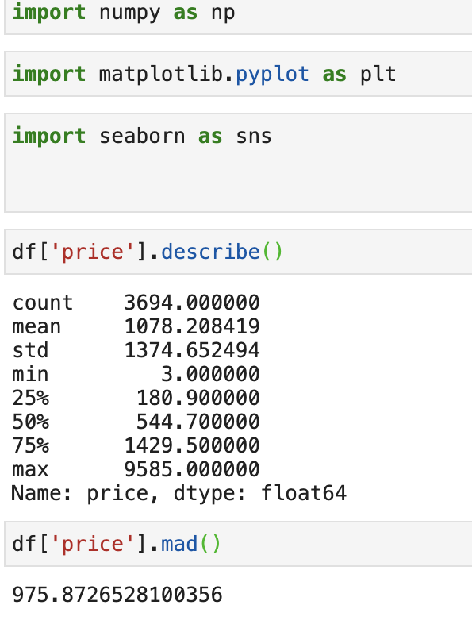
eda

Slide 13
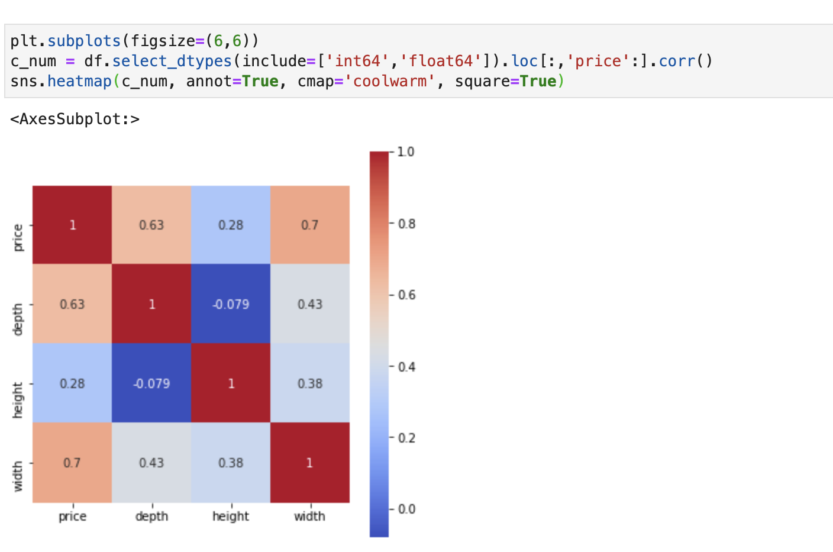

Slide 14
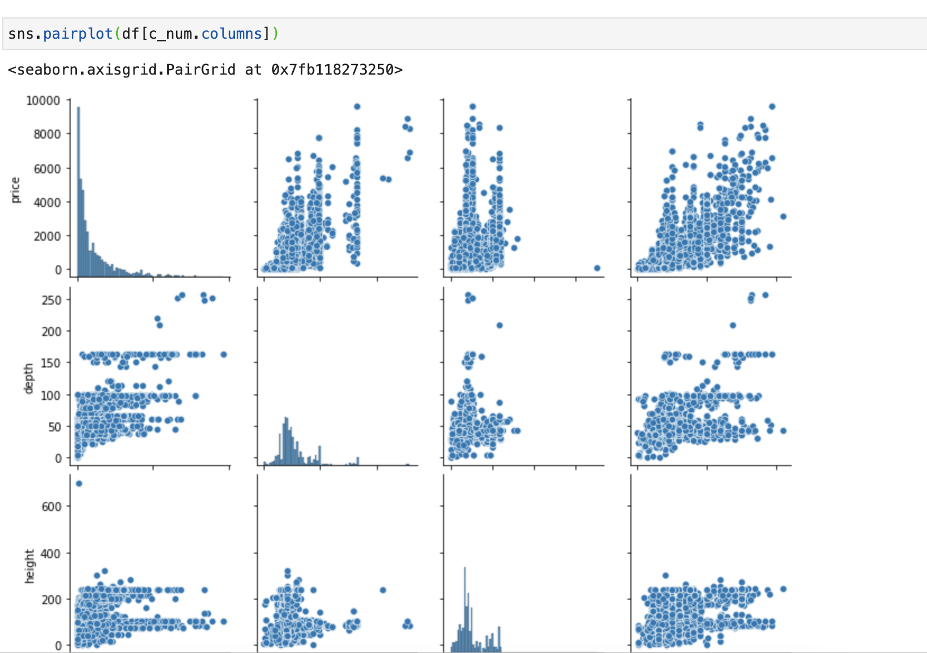
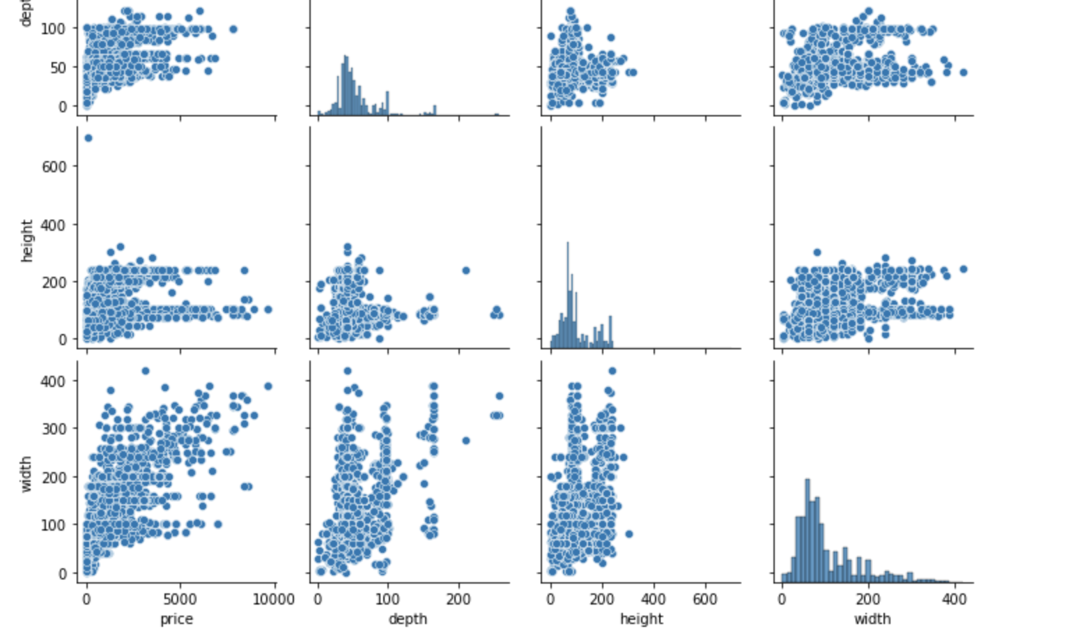

Slide 15
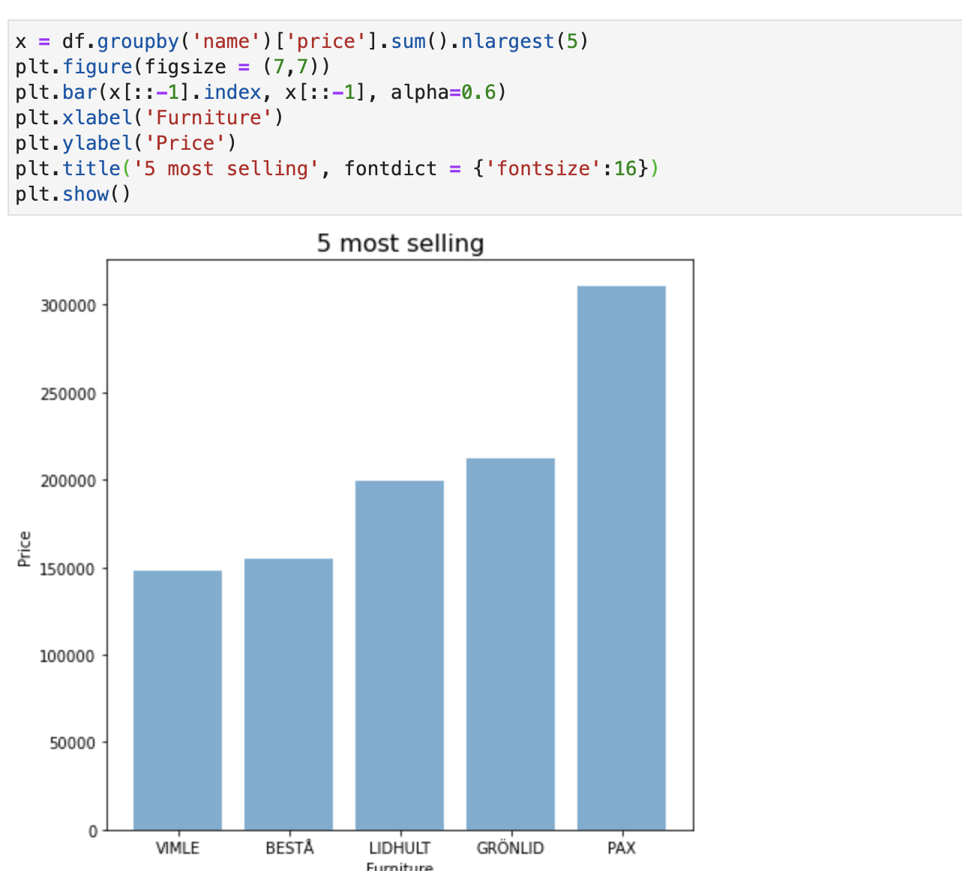

Slide 16
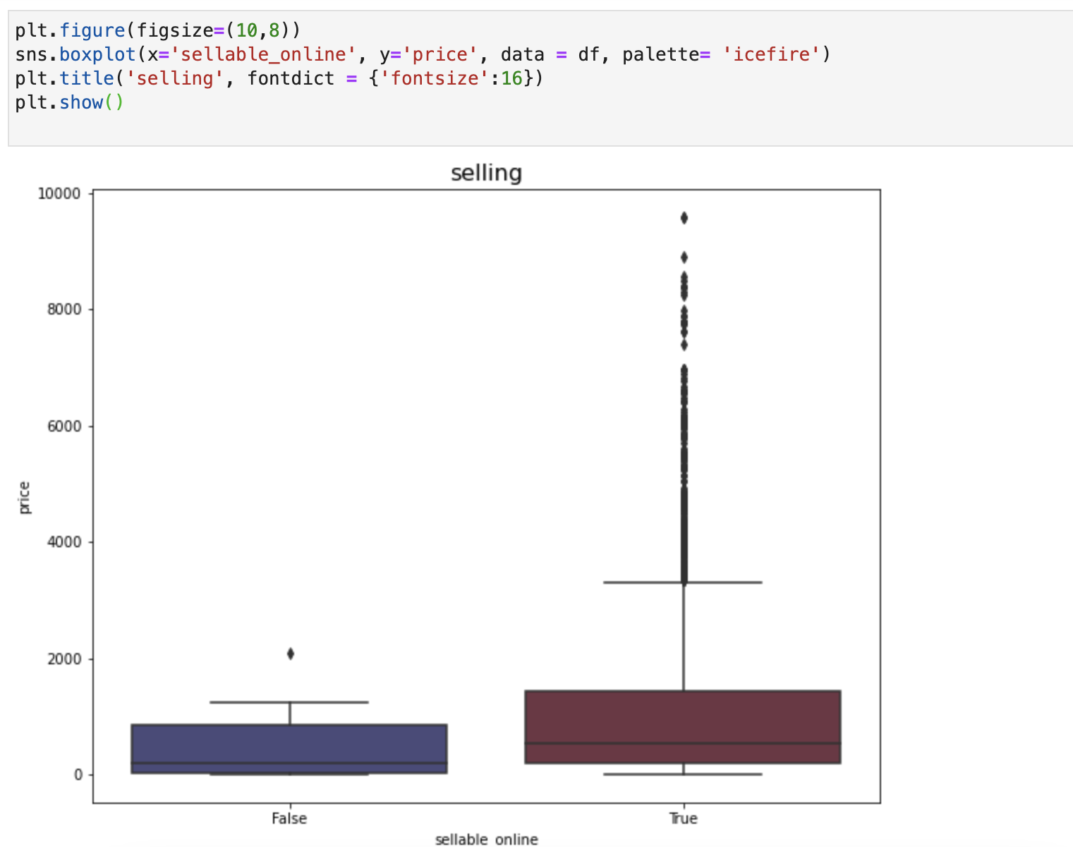

Slide 17
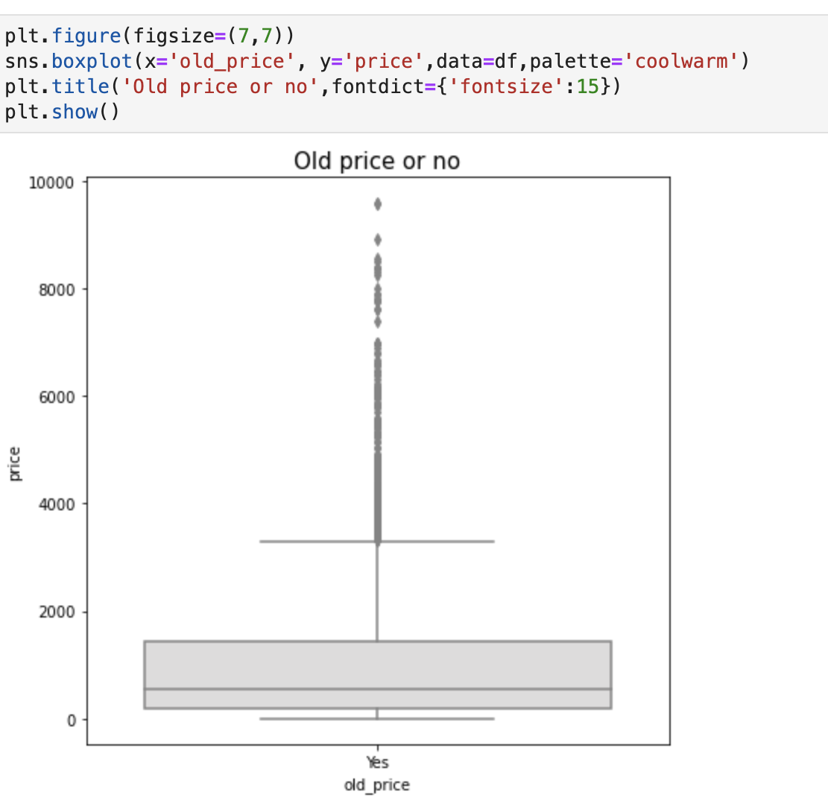
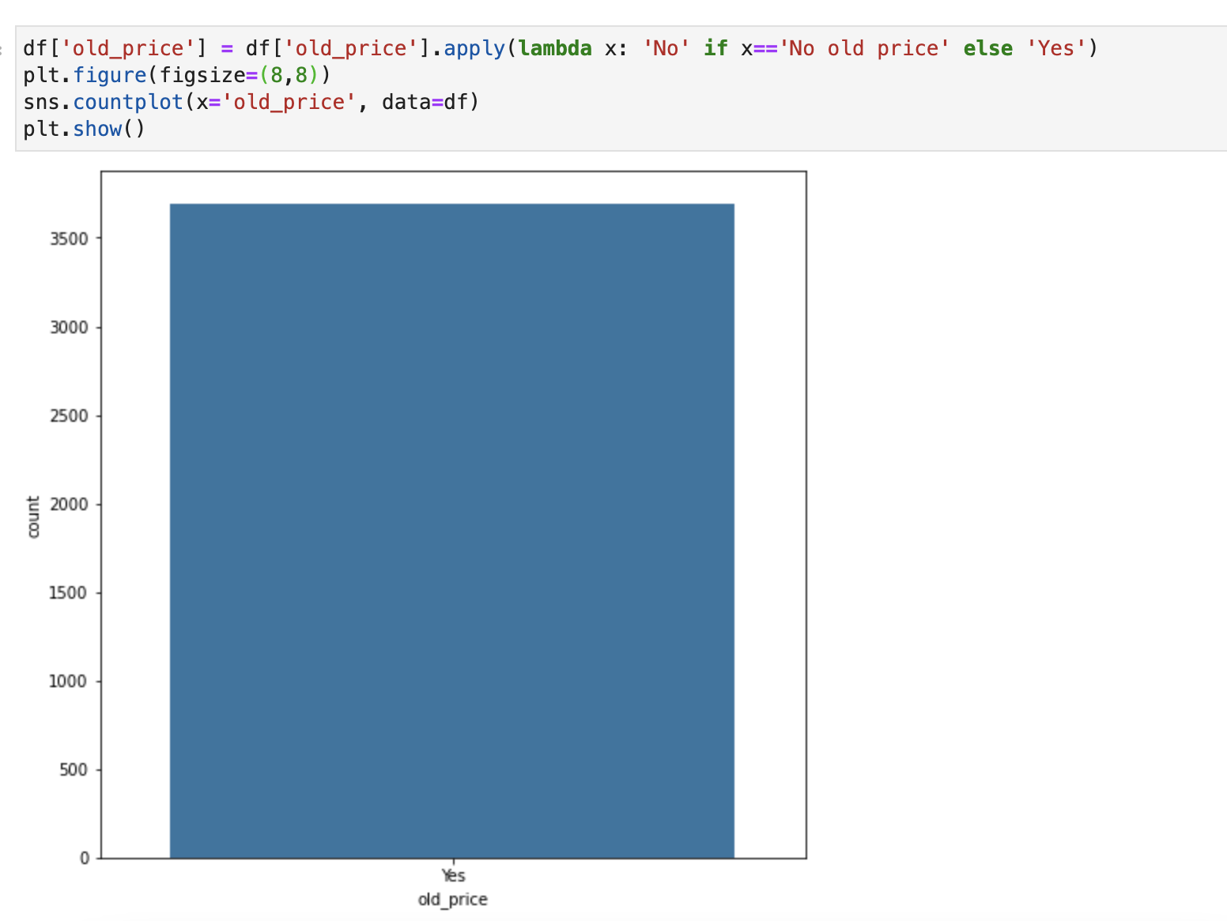

Slide 18
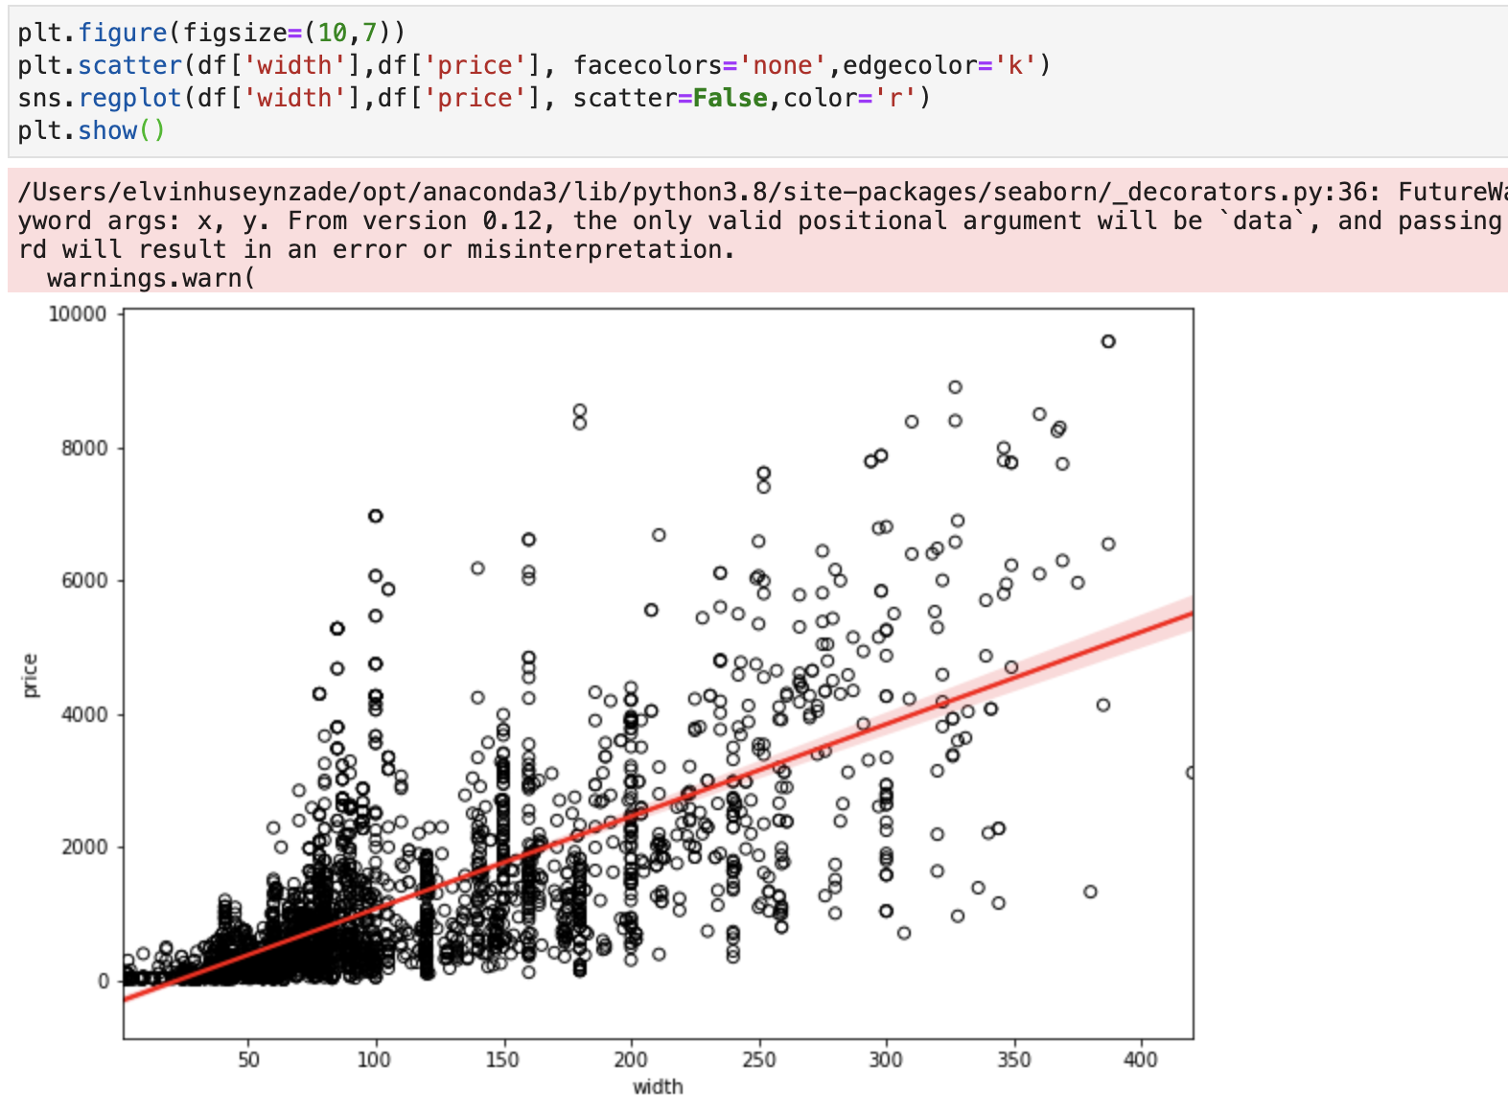

Slide 19
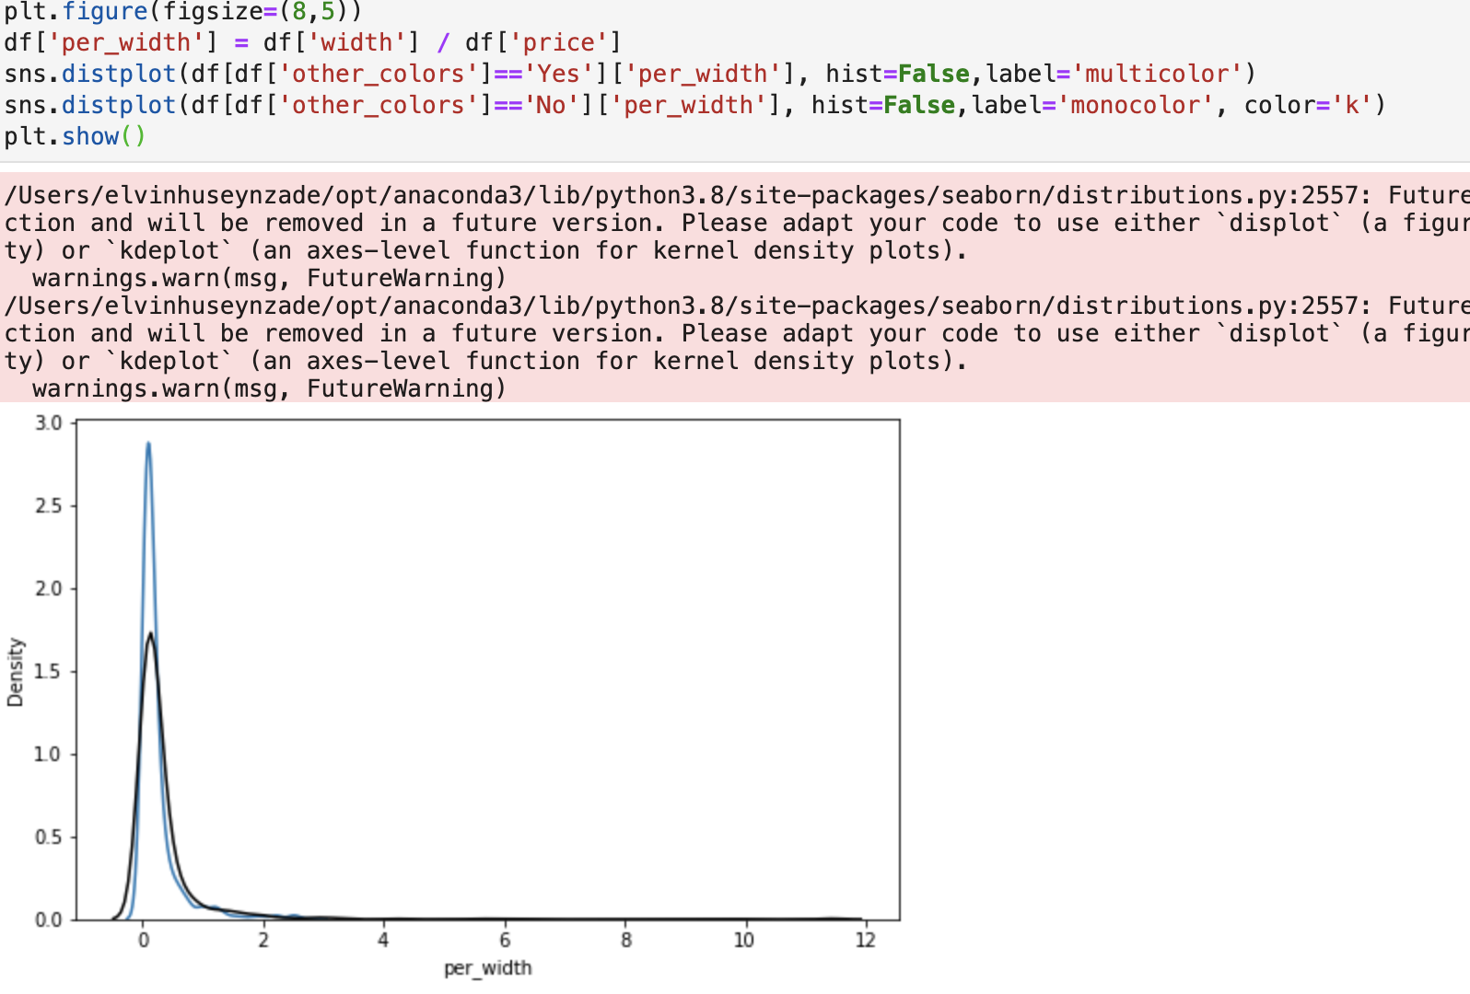

Slide 20
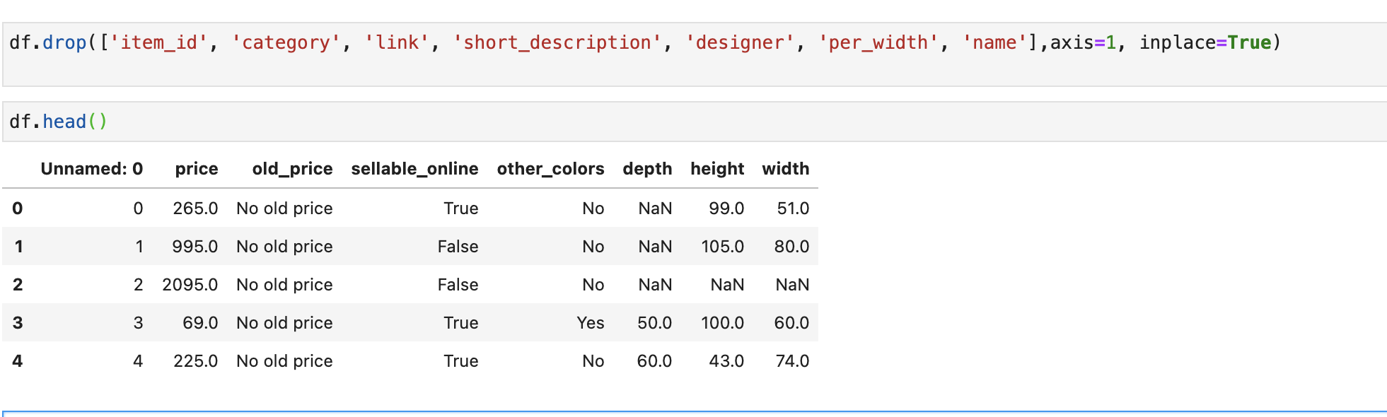
model

Slide 21
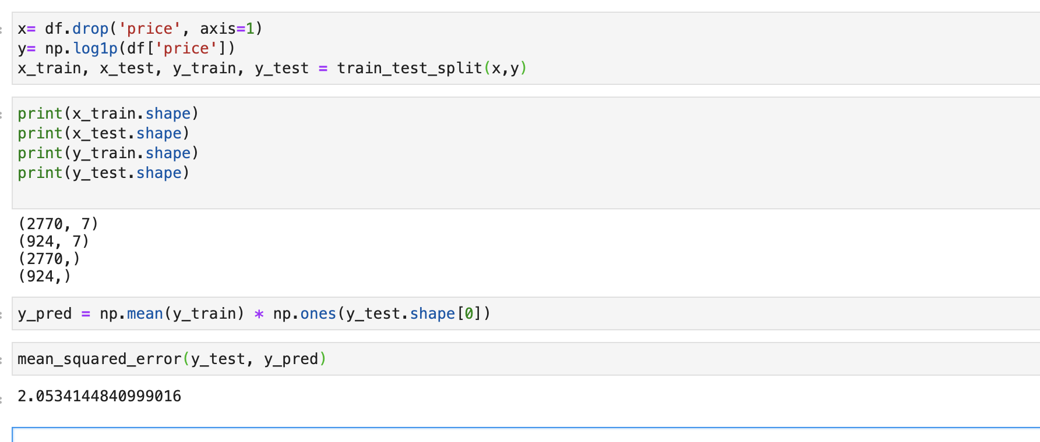
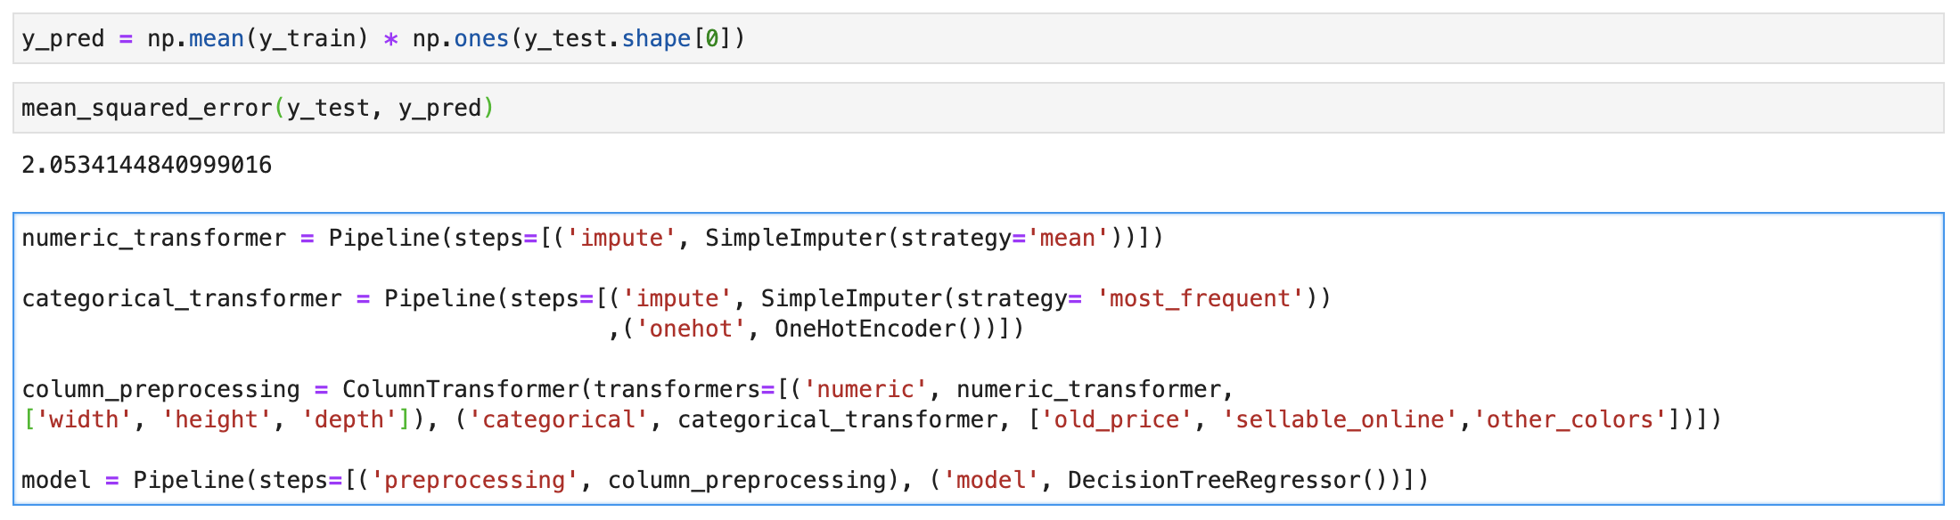

Slide 22
TABLEAU
DASHBOARDS
DEPARTMENTS
EMPLOYEES
MANAGERS

Slide 23
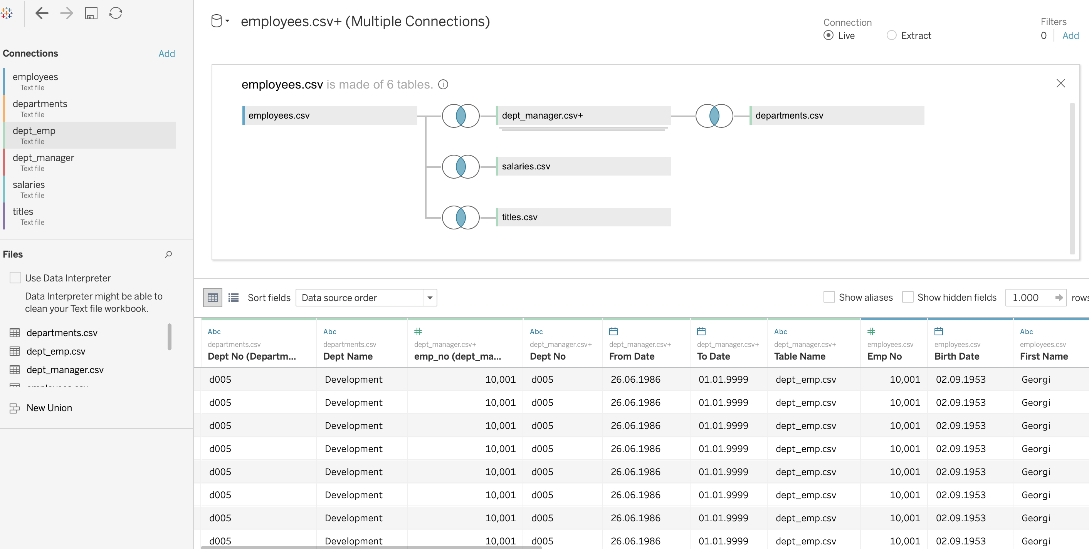

Slide 24
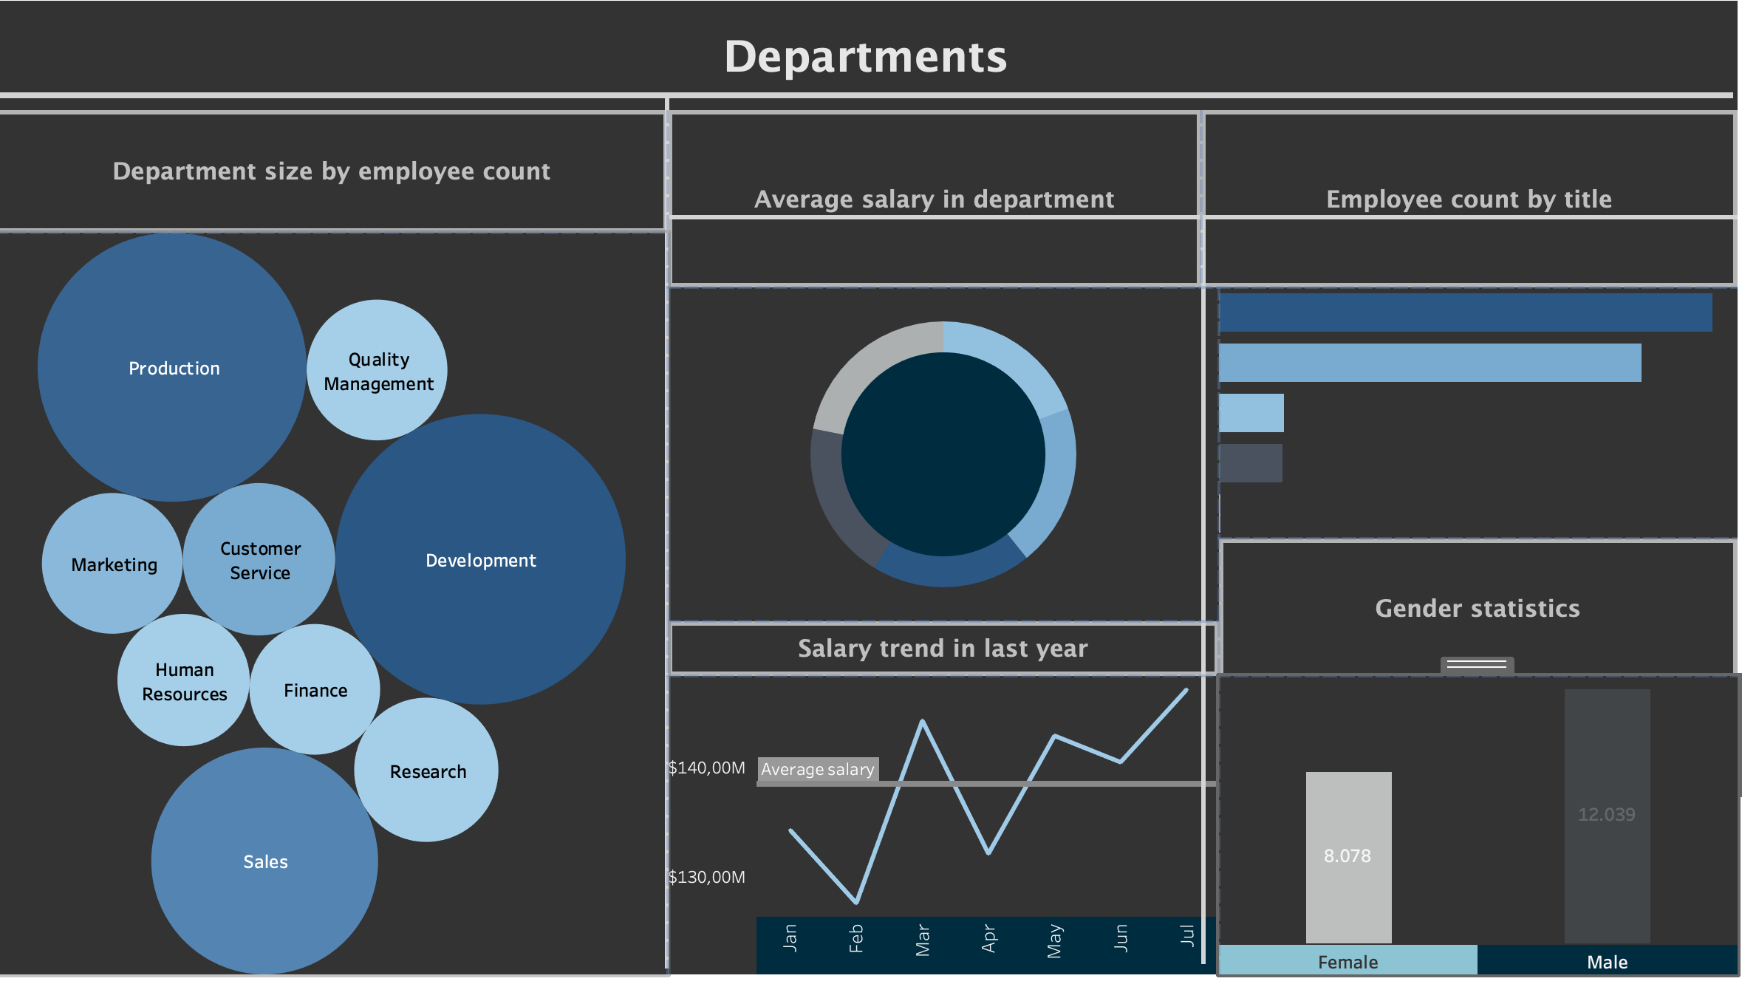

Slide 25
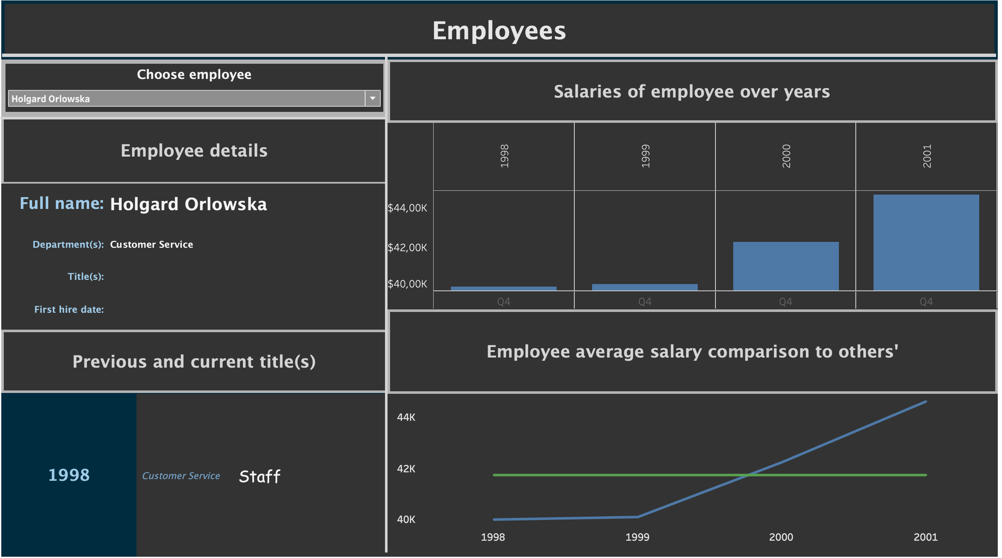

Slide 26
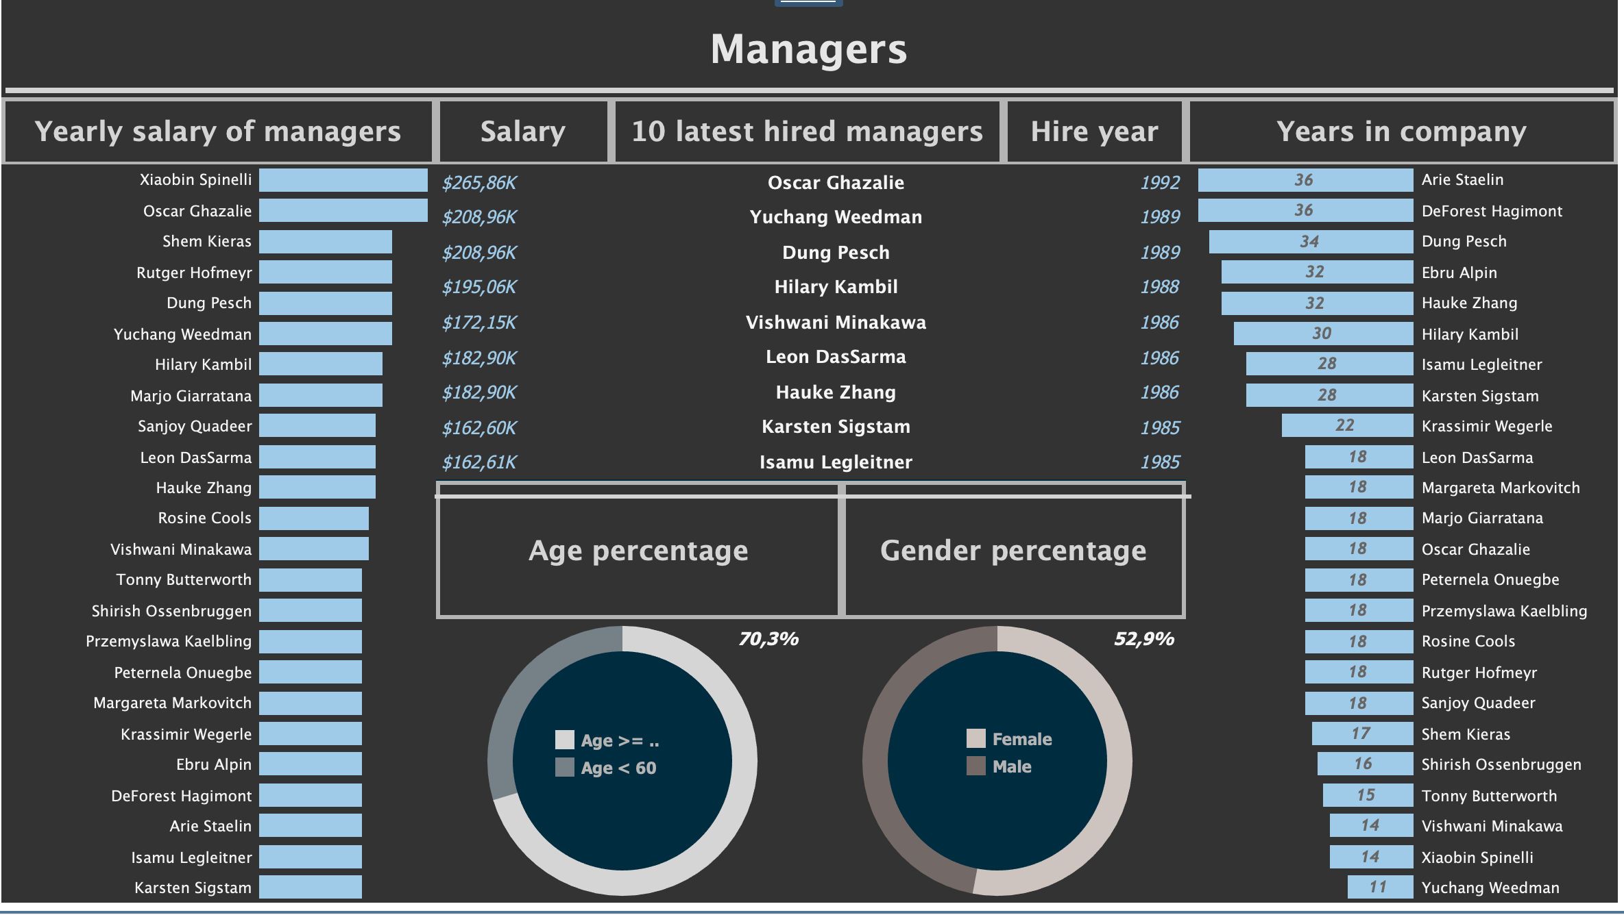

Slide 27
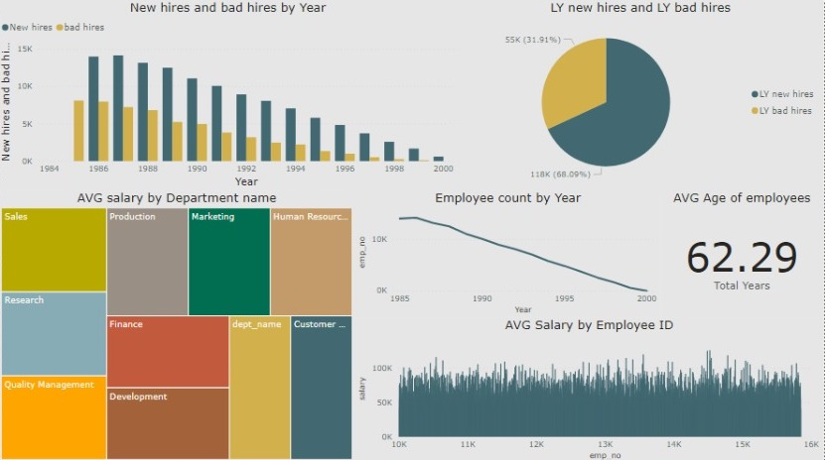
POWER BI

Slide 29
Thank you for your attention!

